Slide 1
Maximising your learner’s success
Rachel Roberts and Simon Ormerod

Slide 2
Aims of today
How can we help guide our learners’ development for life as GPs?
How can we help them pass the CSA?
Use group-work and our skills as trainers
Fun with film clips -“challenging scenarios”
Trainers to design questions, and signpost to resources

Slide 3

Book contains all the ideas listed here
Has accompanying website with clips of consultations ready to role- play and also “challenging scenarios” or ethical dilemmas
Using some of these clips today
Is non-profit-making. proceeds to NE London faculty RCGP
Acknowledgements – Anwar Khan, Mei-Ling Denney and Marilyn Graham
Disclosure of any possible potential conflict of interest

Slide 4
Maximising your learner’s success in the CSA
Collect ideas from the group
What worked well?
What to avoid / any times it went less well?
Types of learners for whom certain techniques worked
Pearls of wisdom

Slide 5
CSA factors and learning needs
Candidate
Simulator
Assessment

Slide 6
Candidate factors
Rachel

Slide 7
Teaching trainers to suck eggs?!
“Science with compassion” equal shares
Categories of needs – knowledge, skills and attitudes
Performance on the day / psychological preparation
Worries about myths / factors outside of learner’s control.

Slide 8
Overcoming Barriers
Consultation skills – feedback from colleagues and trainer
Knowledge – suggest RCGP toolkit, assess learning needs, still 2 – 12 weeks or more to go, target your learning
Examination blogs - tutorials , feedback
Performance on the day. Anxiety, time- management, ability to fall into natural role -playing (Aiming for close as possible to comfort zone)

Slide 9
CSA f/b common problems
Structure
Does not develop a management plan (including prescribing and referral) that is appropriate and in line with current best practice
Does not identify the patient’s agenda, health beliefs and preferences
Does not make use of verbal and non-verbal cues. Active Listening
Does not develop shared management plan or clarify the roles of doctor and patient
TIME is a symptom not a diagnosis
Dr P Trafford, London Deanery

Slide 10
Skills - interpersonal
“ In any interaction the person with the greatest behavioural flexibility has the most influence on the outcome”
“Discover the person’s perceptions before you seek to influence them”
Role-players will respond to positive and empathic attitudes
If the way you are approaching a consultation is not working, be prepared to change your approach.

Slide 11
Tools for performance worries
Identify, challenge and replace unhelpful thinking
E.g. replace “I will fail”, with “there is evidence that my consultations are good” e.g. trainer and PSQ feedback, etc.
Replace worries about any disadvantage with tools to overcome – if I tend to speak too quickly, start initial introduction deliberately calmly, slowly and with a smile

Slide 12
“ Act calmly”
Body language - impact on interaction and self confidence
Anxiety can itself be the barrier to hearing the patient’s agenda – try to focus on the patient entirely (anxieties fade into background)
Clear head from all thoughts of past case at 10 min. bell

Slide 13
Elements of NLP
Make your goals realistic
Interpersonal skills “what is good eye contact?” “mirroring” / comfort zones
NLP – insights into how people behave, and ability to achieve positive outcomes
Ability to adapt your own behavioural responses to stress
Resource Reg Connolly, pegasus NLP

Slide 14
Positive imagery
Practise consultations and get feedback
“Anchor” the picture in your mind of you consulting at your best - discuss
Practise repeatedly in normal life between consultations, see if that increases your confidence and improves performance
Practise when consultations become difficult
Use before the exam and during, always when your confidence wavers

Slide 15
Possible resource
10 anxiety mangement techniques, Cornwall Mental Health

Slide 16
My key candidate message

Slide 17
Consulting effectively in CSA
Become interested and curious
Create rapport
Ask questions
Listen and check your understanding of what they describe
Pay particular attention to their non-verbal communication
Leave enough time for management
Adapted from Reg Connolly + pegasus NLP

Slide 18
Dave Russell
The Simulator

Slide 19
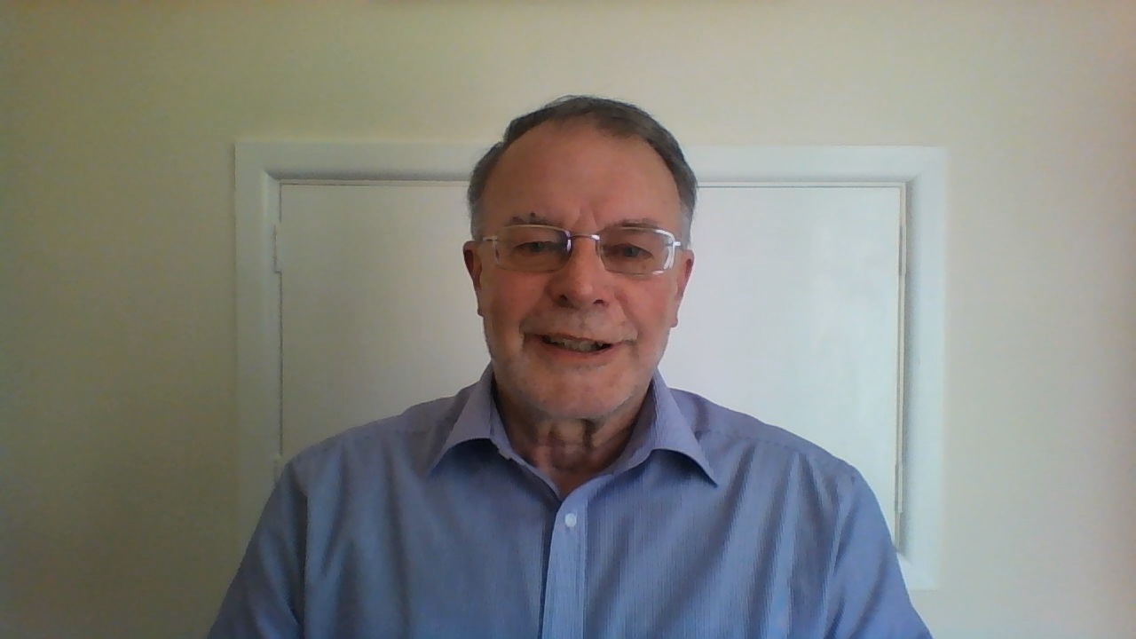

Slide 20
Assessment issues - Simon

Slide 21
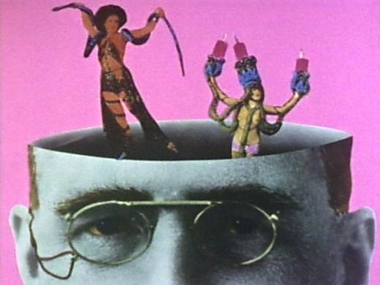
Something old
(said in a newish way)
Coming at things another way?
What is going on in the examiner’s head
  (a personal view)

Slide 22


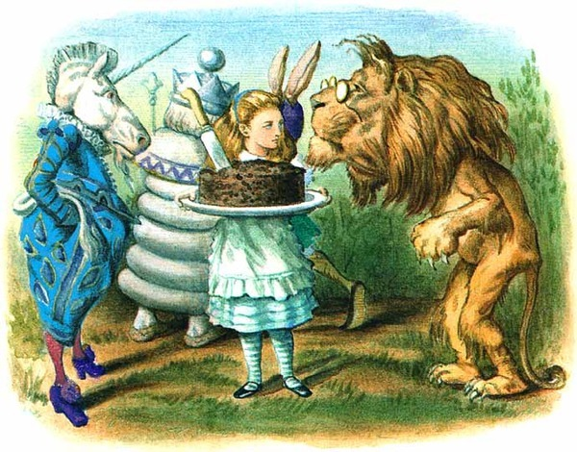
Cum Scientia cAritas
Notes:
…..but there is a lot more of this going on!!!

Slide 23
Cum Scientia cArroll-as
Notes:
…..but there is a lot more of this going on!!!

Slide 24
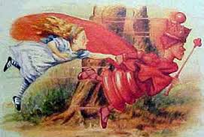
Notes:
…..the topsy turvey world inside the examiners head

Slide 25
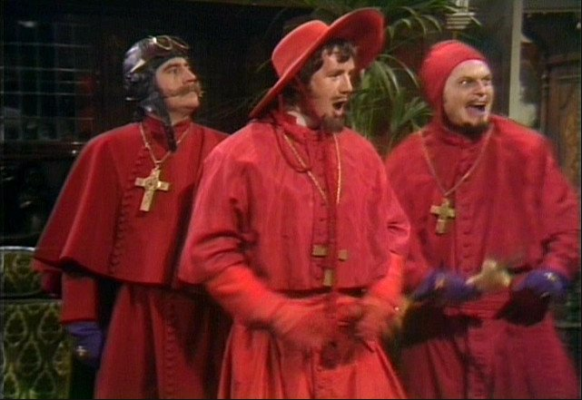
Nobody appreciates……..
Notes:
Its stressful being one of these people

Slide 26
Marking Grades
Clear pass (3) Awesome
Pass (2) Good enough
Fail (1) Not good enough
Clear Fail (0) Not good enough -OK - bad
i.e. Performance in each domain rated out of 3
“GO FOR 9 EVERYTIME”
Notes:
Want to give easy peasy grades decide what borderline actually means going by this years definition and either have tea desultory sandwich lunch or get home to their teenagers / horses or whatever…..

Slide 27
Feedback- examiner POV
Hardest task “justifying marks”
Time pressured-reflective
Performance managed /QA
Uncomfortable negatively phrased
Would rather not have to
Extra work
HOW?
  As trainers help registrars make it difficult for examiners to give any feedback whatsoever……
Notes:
…that is if they werent meant to give feedback.

Slide 28
CSA Feedback in training
“Work forwards from a backwards perspective”
“ …This sounded nonsense to Alice, so she said nothing, but set off at once towards the Red Queen. To her surprise, she lost sight of her in a moment, and found herself walking in at the front-door again.
A little provoked, she drew back, and after looking everywhere for the queen (whom she spied out at last, a long way off), she thought she would try the plan, this time, of walking in the opposite direction.
It succeeded beautifully. She had not been walking a minute before she found herself face to face with the Red Queen, and full in sight of the hill she had been so long aiming at."
  Chapter II Through the Looking Glass – The Garden of Live Flowers
Notes:
TAKE A MOMENT TO RE CONNECT WITH THIS RESONATING SCENARIO
The contradictory and contorted process of deconstruction and reflection that characterises ST training for general practice especially the “Ta-dah” moments when thinks click, have a great metaphor in the Looking Glass World and how we went about re writing the CSA Feedback statements in Chapter 6

Slide 29
CSA-COT Feedback use the inverted statements
NE & Central London CSA Course case feedback & log learning tool
Case synopsis details
DOMAIN | Done well | Could be done differently
Data Gathering
Clinical Management
Interpersonal Skills
Global features Comments
Learning points Actions/ Educational prescription, Revision tips
Chap 6 The CSA -Maximising Your Success

Slide 30
Party Bag - message
At every step from induction to CCT assist learners to go for gain – marginal will do!
Re-flect / Feedback – use all the portfolio tools all the time diversely PDP - have a plan
Re-create- peg learning and the learning environment to assessment synergy
Re-assure - Examiners are human and diverse – Like (most) GPs they are stressed too

Slide 31
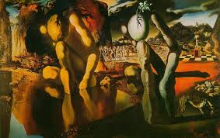
The Metamorphosis of Narcissus- Salvador Dali
Notes:
Narcissus starved himself to death contemplating his own reflection- reflection without action = education without service commitment

Slide 32

Anjum Iqbal -Challenging Cases Section 1
Titanic avoids Ethics iceberg
Non-maleficence
Beneficence
Autonomy
Justice
Professional values
Scientific values
Legal issues
Cultural and religious beliefs
Moral convictions
Medical defence union
Notes:
Apology, but a brief reminder of ethical principles and the underlying values would be helpful to all trainees.
Ethical challenge - The big four ( autonomy, beneficence, non maleficence, justice ) remain in the forefront of our doctors minds a bit like the top of an iceberg.
If we appreciate that we are in the middle of an Iceberg field the whole time and that navigating this with help of skills/knowledge/ intutition/ team work / experience support from resources like MPS/ BMA and patients themselves, we can and do get through it safely and amazingly in every surgery we do…and get even better at it with the practice of simulations like the CSA…..
However it is important to remember the many values upon which any decision is based ; these are fluid , complex and like an iceberg floating along changing scenery and size and importance with time. An example of professional values would be GMC guidance. The scientific values would be the continuously changing evidence in the weekly BMJ & NICE guidelines. The legal issues would be involving TOP & end of life issues. During our consultation , if we SPICE our patient then any management would incorporate the patient’s cultural and religious beliefs , for example, blood transfusion for a Jehovah’s Witness .

Slide 33
Video clip catalysts
Website has 12 clinical clips, with matching written cases with marking schedules in the book – main attraction for learners
Additional 6 ethical dilemmas to stretch people and useful as trainer resources.
Thank you to Anwar Khan for the ideas of the ethical scenarios

Slide 34
Challenging Cases Section 2
Sore throat probably Viral – pt wants Antibiotcs
 | Option 1 | Option 2 | Option 3
 | NO antibiotic | Give Antibiotic | Delay Antibiotic
Autonomy | ? | Y | Y
Beneficence | Y | N | Y
Non-maleficence | Y | N | Y
Justice | N/A | N/A | N/A
VALUES underlying
Professional – GMC | Y | N | Y
Evidence base Medicine | Y | N | Y
Legal values – law | N/A | N/A | N/A
Cultural and religious values | N/A | N/A | N/A
International law | N/A | N/A | N/A
Moral convictions | N/A | ? | N/A
Notes:
Now let’s apply the ethics iceberg principle to a simple common dilemma of whether to prescribe antibiotics are not in a patient where the sore throat is probably viral . To simplify this. I have listed the ethical principles on the left column in the spreadsheet and the options for treatment across the top. Three abbreviations have been used Y= yes , N = No , N/A = not applicable . The? Equates to a debatable issue. It looks like a very busy slide at a glance; however You will see more Y = yes in the column where the management involves no antibiotic and delayed antibiotic column implying these are the better options for treating the patient with a sore throat.
On a separate but important note. Please remind the trainees to think of differentials of sore throat presentations eg – post nasal drip , reflux , poor technique in steroid asthma inhaler causing pharyngeal / oesophageal thrush , - more serious – quinsy , secondary to neutropenia in pt on methotrexate / carbimazole , referrred pain angina etc.

Slide 35
Challenging Cases
Summary –3 steps to Gain confidence
1- GP – Generally Practise & see as many patients as possible – discuss with trainer
2- LLL – Subscribe to Life long Learning
3- DRE – Do-Reflect-Evolve – Like Roger Federer –
i.e Even if you are the best GP in the world - ‘There are still areas I can improve’
Notes:
Finally, to conclude on how to gain confidence in handling challenging patients and ethically demanding situations – there is no secret but
firstly GP - Generally Practice and see as many patients as you can and discuss difficult challenging patients with your trainer.
Secondly internalise lifelong learning as an regular task because there is an avalanche of medical evidence which is constantly changing and hence we need to constantly update our knowledge and skills.
Thirdly ,while you’re in general practice everyday reflect and continue to try and improve in all areas of the consultation . Use the principle of the best tennis player - Roger Federer – even if you are the best GP in the world – everyday think ‘ there are areas I can improve ‘
Thank you

Slide 36
Group work in 4s approx
Play the clip then attempt to role-play rest of consultation (finish by the 10 min). Try to avoid more data gathering ( can confabulate if have to !!)
plays simulator,
plays candidate,
plays trainer to ask learner after role play e.g. what are the issues? What are the pros and cons of any actions?,
acts as resource investigator - What resources would you suggest to learners to explore the issues?

Slide 37
Challenging Cases Section 3
Examples
John Dyson – 1.35- daughter address
Cut hand - 1.55 – Break in
Practice Nurse – 1.36 – GP & PM
Roger Truman – 2.59 - Home vs Hospital
Dr Reuben – 6.40 – GP SSRI
Notes:
As I promised earlier , here are some possible ethical dilemmas we can face in general practice and can be practised with your trainee .

Slide 38
Conclusion
Experiences we have had of using such clips as catalysts in tutorials and groups
Are there ideas we could use in our practices from this?
Are there ideas / resources/ trainer wisdom we can put on our TWS website?
Should we all film challenging scenario role-plays for our learners?

