Slide 1
Trainers facing learner issues
Ann Telesz 23/09/16

Slide 2
Aims of session
Introduce types of difficulty
Discuss experiences
Look at support available
Look at learning resources
http://www.faculty.londondeanery.ac.uk/e-learning/managing-poor-performance

Slide 3
Different types of difficulty
Difficulty in progress eg exam failure
Transient difficulty in personal life needing support
Personal conduct and attitudinal issues

Slide 4
Common circumstantial problems for trainees
educational challenges, exams, revision
anxiety concerning career decisions
pressure of work, lack of team support
unfamiliarity, inexperience
changes in team dynamics
personal health problems
sickness within the family
personal relationship difficulties
cultural isolation, culture shock (e.g. overseas graduates)
domestic responsibilities or pressures

Slide 5
Group work
Think of a trainee in difficulty you have supervised in the past.
How were you alerted to the possible difficulties the trainee had?
Was it an isolated instance or were you aware of a repeating pattern of concerns?
What information did you need to help the trainee?

Slide 6
Which tools for which areas?
Communication skills
Clinical reasoning
Practical skills
Insight into performance
Teamworking

Slide 7
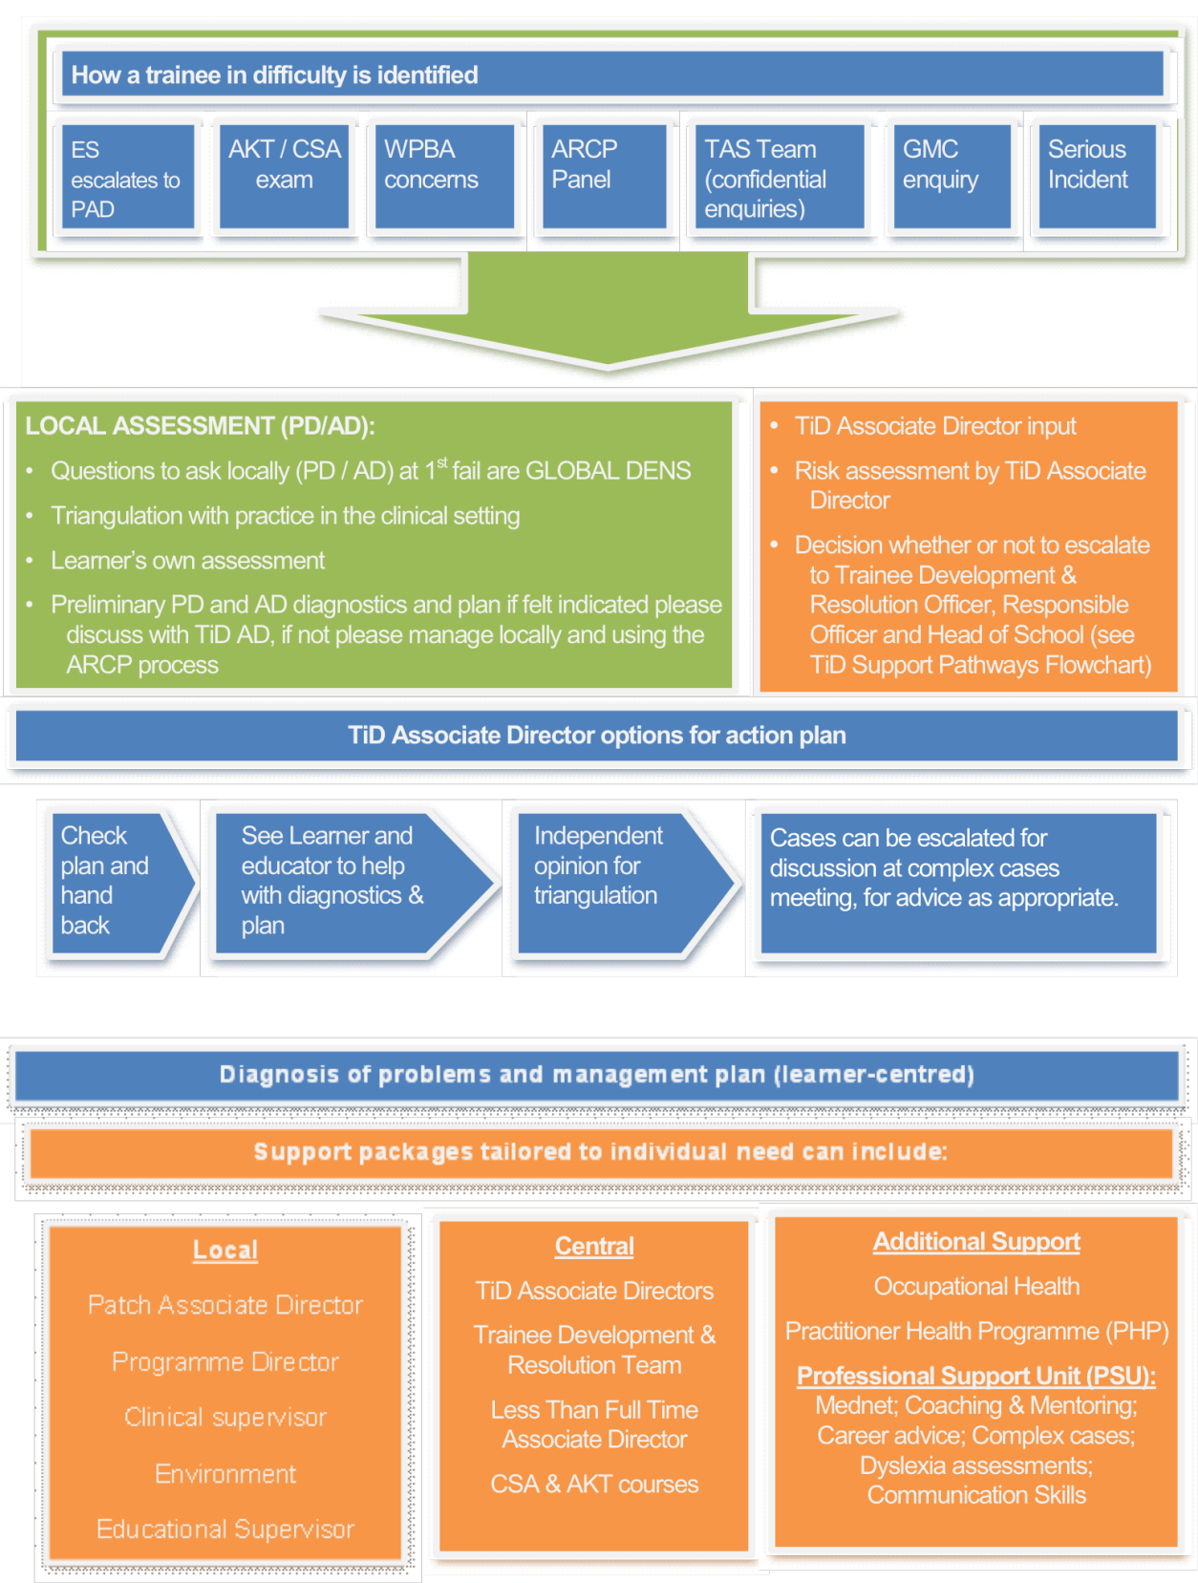

Slide 8
Golden rules
1. Try to create an open, trusting relationship with your trainee, where the relationship between work and life is acknowledged and respected.
2. Know about support structures. A trainee in difficulty is likely to require advice and guidance from a range of people and likely so will you.
3. Keep contemporaneous records of all encounters with the trainee using personal record and the eportfolio educators notes as appropriate
4. Use workplace-based assessments diagnostically. It is vital that you are explicit about labelling all causes for concern and that these are recorded.

Slide 9
Golden rules 2
5. Set realistic goals for improvement, monitor these and record outcomes. Give clear feedback, based on observable behaviours and with specific suggestions for improvement.
6. Remember that trainees in difficulty are also employees in difficulty, who may put patient care or safety at risk. Involve appropriate colleagues within your practice and educational network at an early stage then escalate as appropriate.
7. You are the person who must make the final judgment that they are Competent for Licensing. If you have concerns then share them earlier rather than later.

