Slide 1
REDRIDGE AND WALTAM FOREST TRAINERS WORKSHOP
Jan 2019

Slide 2
Agenda
Workshop Guidance
Paternity/parental leave
HEE Update
Year planning including away days
AOB

Slide 3

  HEE new guidance for trainers workshops October 2018
  Purpose:
  Continued professional development of new and established GP trainers
  Trainer peer support
  Discussion of training related matters including latest processes and policies
  Contribute to the smooth running of postgraduate GP training locally

Slide 4
Groups are required to meet at least 6 times per year for a minimum of 1.5-2 hours on each occasion
TRAINERS ARE EXPECTED TO ATTEND AT LEAST TWO THIRDS

Slide 5
R&WF TWS
Five meetings each year 2.5 hours (inc lunch)
Away days 2 days/ 2 meetings cpd hours normally 11-12 hours
Total hours in year 21 (not including lunch)
2/3 = 14 hours
2/3 of all meetings (5TWS 2 AD = 7) = 4.6?

Slide 6
Facilitating Professional Development | Disseminate policies | Workshops Emails
 | Encourage attendance at HEE recommended educator course | Forward emails – added to diary dates
 | Encourage attendance at Panel
 | Peer review | Session for peer appraisals
 | Facilitate sharing and feedback relating to training programmes and local PDs | Feedback taken at away days

Slide 7
Facilitating Educational development | Co-ordinate buddying system/mentoring | Opt in for mentors –details on website Let convenor know arrangements
 | Identify learning needs on a regular basis | Jan and away days
 | Develop and educational programme | Done after Jan LNA
 | Encourage self directed learning and peer teaching within group | Away day teaching exercise. Volunteers please!
 | Group Callibration WPBA | Due
 | Promote opportunities where teaching and supervision skills can be peer reviewed | Away days ? workshops
 | Peer feedback | Teaching excercises
 | Laise with HEE for appropriate access to support | Eg speakers and rota concerns

Slide 8
Facilitating peer support | Allow time at each meeting | AOB at meetings, can notify in advance or on day
 | Allow adequate time for supportive structured small group discussion at each meeting | Large group Lunch?
 | Seek regular feedback | Survey 2014 and subsequent feedback from away days
 | HEE structures for TIDs | ? website

Slide 9
Paternity leave
Ordinary:2 weeks allowed no extension to training
Shared parental leave (mother/adopter can transfer maternity entitlements to father/adopter after first two weeks up to 52 weeks) Requires 8 weeks notice

Slide 10
Parental leave
Those with parental responsibility can take 18 weeks per child under the age of 14 (18 in cases of adoption or disability).
Up to four weeks in a 12 month period
Unpaid, pro rata
Contact:
Khalid EL Hasnaoay
Medical HR advisor
Royal Free
0208 375 1800 ext 35545
khalid.elhasnaoay@nhs.net

Slide 11
HEE Updates
Eportfolio Access issues: Email HET team re eportfolio access Gp north.lase@hee.nhs.net. Trainees can use portal
Local support pathway in process. Good evidence that if trainees take too early and don’t pass, demoralising and less likely to do well at next attempt. Escalate early.
Inter professional learning : VTS one session per term inter professional learning
192 trainees in London - FULL
ES study leave form sign off mandatory, optional, aspirational when in hospital. ST3 GP only 500
Sick leave 10 working days
Indemnity: August 2018 all trainees block MDU cover. Practice should check that trainee has indemnity
(FY2 get covered by trust indemnity)
Sarah Jane Wong guardian of safe working. Hardly any exemption reporting raised. (? invite to TWS)

Slide 12
Workshop for returners will be offered and be in touch Alex Kelly in new year, main maternity (already been contacted waiting to get date)
GMC feedback. Has been released by TPD and PAD. End of placement feedback
Lone worker policy. Supervision: phone or in person
GP LEO needs, employment wise, not to do with supervision
Cremation fees : meant to go to trainees (Salaried into contract?)
OOH: 72 hours. 48 minimum aim for 72. Watch this space as factored in. Check local hub for ? OOH
Need to notify CQC results
Next meeting: June 4th 9-12

Slide 18
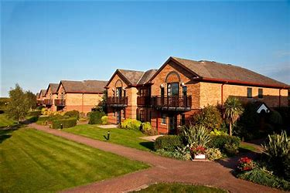

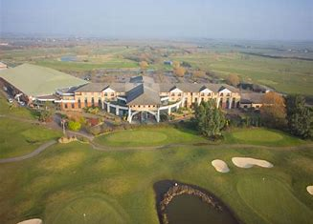
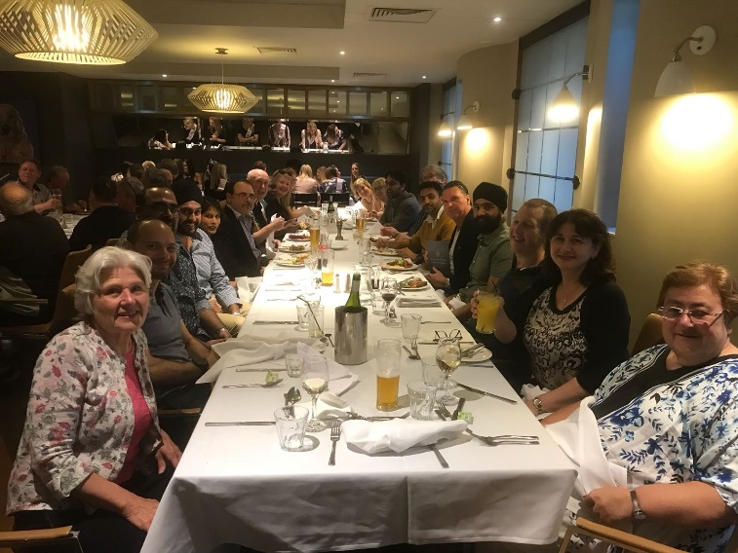
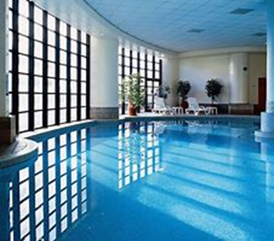
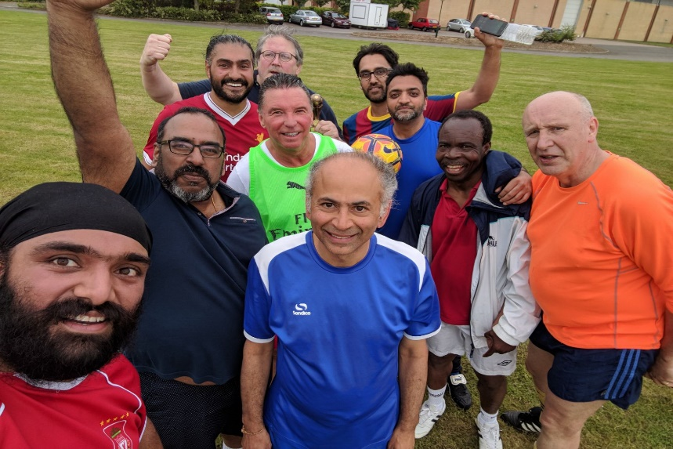
Away Days 10th-11th May

Slide 19
Ideas and Volunteers?

