Slide 1

Waltham Forest and Ilford
GP trainers workshop
John Launer
12 June 2020

Slide 2
Recommended Zoom settings
Generally:
Mute yourself when not speaking
Hide self view to reduce distraction
Switch between speaker and gallery view to maximise engagement
For watching a two-way conversation from a fishbowl:
Mute yourself
Stop your video
Go to Video Settings, look for Meetings, scroll down, tick “Hide non-video participants”

Slide 3
Cases for discussion
What current dilemmas do I have that would benefit from ‘talking things through’ confidentially?
NB: These scenarios need to be: -
CURRENT: (not already solved / in the past)
REAL: (not a hypothetical situation)
YOUR OWN: (not someone else’s problem)
INDIVIDUAL: (dealing with a particular individual or team, not generic issues)
HOT (causing you concern but also suitable for sharing with the group)

Slide 4
The Seven Cs
.
Conversations
Curiosity
Contexts
Complexity
Challenge
Caution
Care

Slide 5
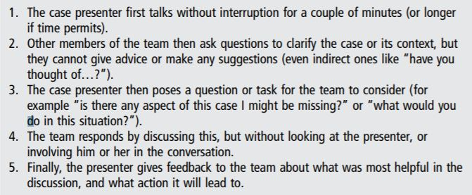
.

Slide 6
www.conversationsinvitingchange.com

